Slide 1
Model Serving Patterns
Pravin Y Pawar
Extracted from
Three Levels of ML Software

Slide 2
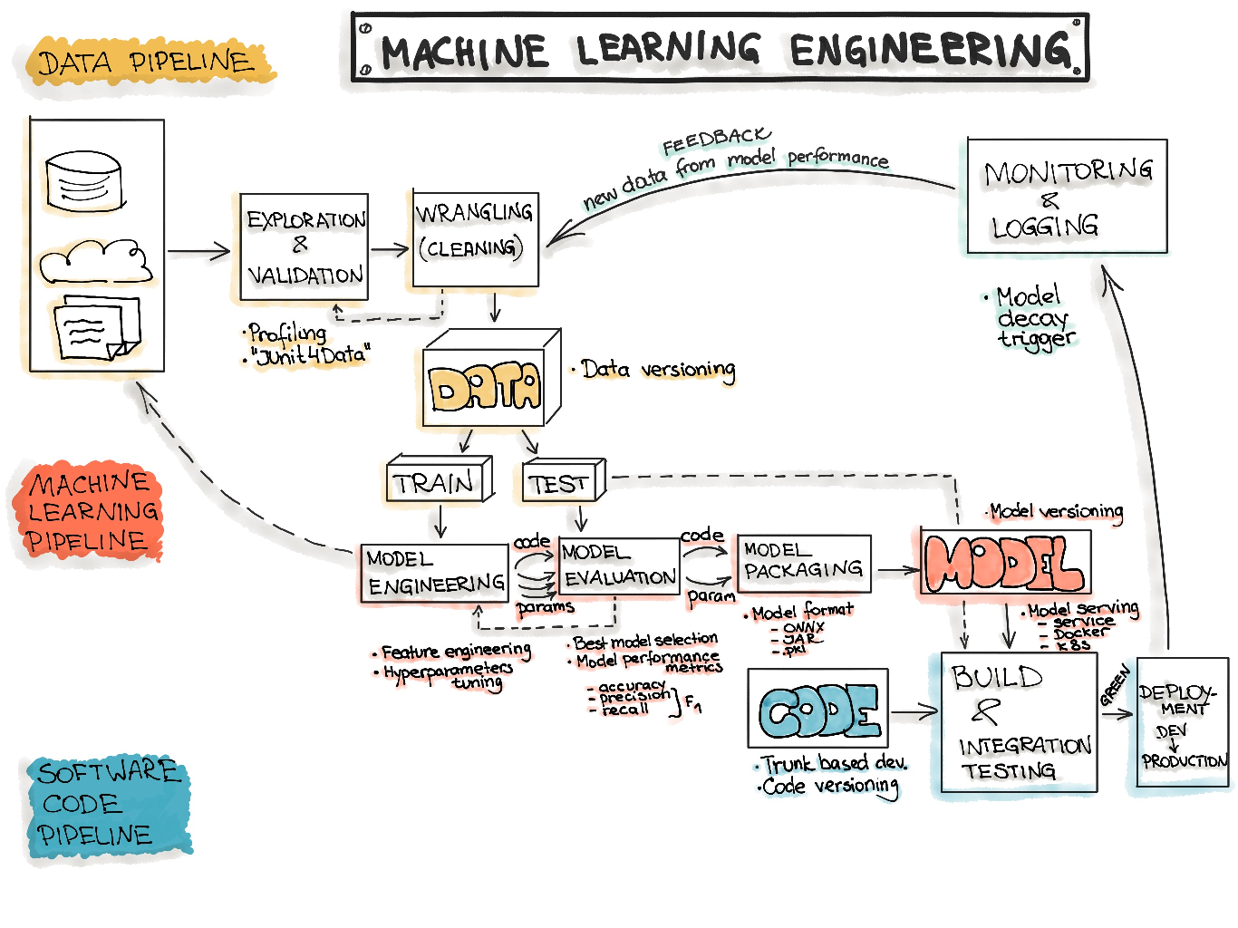
Machine Learning Workflow

Slide 3
Code: Deployment Pipelines
The final stage of delivering an ML project includes the following three steps:
Model Serving
Model Performance Monitoring
Model Performance Logging
Model Serving
The process of deploying the ML model in a production environment
Model Performance Monitoring
The process of observing the ML model performance based on live and previously unseen data, such as prediction or recommendation
interested in ML-specific signals, such as prediction deviation from previous model performance
signals might be used as triggers for model re-training
Model Performance Logging
Every inference request results in a log-record.

Slide 4
Model Serving Patterns
Three components should be considered when ML model is served in a production environment
The inference is the process of getting data to be ingested by a model to compute predictions
requires a model, an interpreter for the execution, and input data
Deploying an ML system to a production environment includes two aspects,
First deploying the pipeline for automated retraining and ML model deployment
Second, providing the API for prediction on unseen data
Model serving is a way to integrate the ML model in a software system
Five patterns to put the ML model in production:
Model-as-Service
Model-as-Dependency
Precompute
Model-on-Demand
and Hybrid-Serving

Slide 5
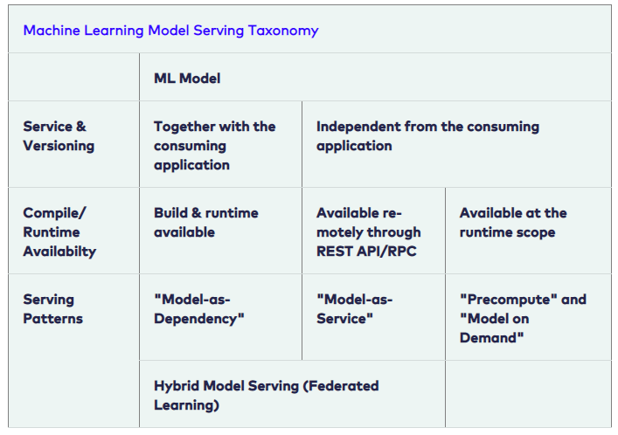
Model Serving Patterns(2)
Machine Learning Model Serving Taxonomy

Slide 6
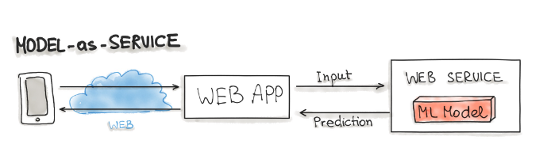
Model-as-Service
A common pattern for wrapping an ML model as an independent service
can wrap the ML model and the interpreter within a dedicated web service
applications can request through a REST API or consume as a gRPC service
Used for various ML workflows
Forecast
Web Service
Online Learning

Slide 7
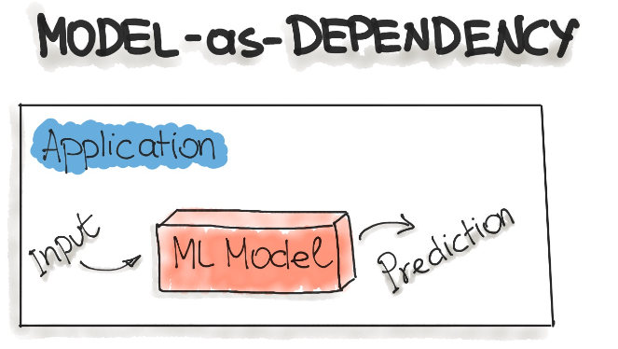
Model-as-Dependency
Probably the most straightforward way to package an ML model
mostly used for implementing the Forecast pattern.
A packaged ML model is considered as a dependency within the software application
For example, the application consumes the ML model like a conventional jar dependency by invoking the prediction method and passing the values
The return value of such method execution is some prediction that is performed by the previously trained ML model

Slide 8
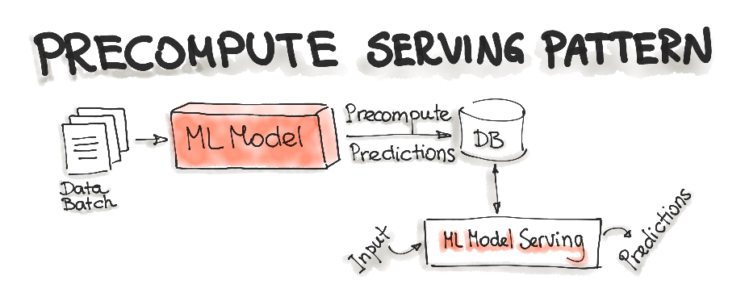
Precompute Serving Pattern
Tightly related to the Forecast ML workflow
Use an already trained ML model and precompute the predictions for the incoming batch of data
Resulting predictions are persisted in the database
For any input request, query the database to get the prediction result

Slide 9
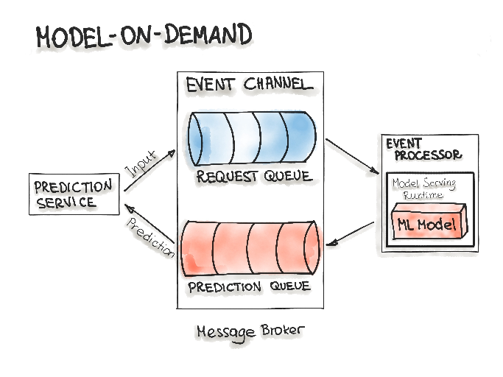
Model-on-Demand
Treats the ML model as a dependency that is available at runtime
contrary to the Model-as-Dependency pattern, has its own release cycle and is published independently
Message-broker architecture is typically used for such on-demand model serving
contains two main types of architecture components:
a broker component
an event processor component
Broker component is the central part that contains the event channels that are utilised within the event flow
The event channels, which are enclosed in the broker component, are message queues
Message broker allows one process to write prediction-requests in an input queue
Event processor contains the model serving runtime and the ML model
connects to the broker, reads these requests in batch from the queue and sends them to the model to make the predictions
The model serving process runs the prediction generation on the input data
writes the resulted predictions to the output queue
queued prediction results are pushed to the prediction service that initiated the prediction request

Slide 10
Hybrid-Serving (Federated Learning)
Unique in the way it does, there is not only one model that predicts the outcome, but there are also lots of it
Exactly spoken there are as many models as users exist, in addition to the one that’s held on a server
Start with the unique model, the one on the server
Model on the server-side is trained only once with the real-world data
sets the initial model for each user
a relatively general trained model so it fits for the majority of users
On the other side, there are the user-side models - really unique models
possible for the devices to train their own models due to hardware enhancements
devices will train their own highly specialized model for their own user
Once in a while, the devices send their already trained model data (not the personal data) to the server
Then the server model will be adjusted
the actual trends of the whole user community will be covered by the model
this updated server model is set to be the new initial model that all devices are using

Slide 11
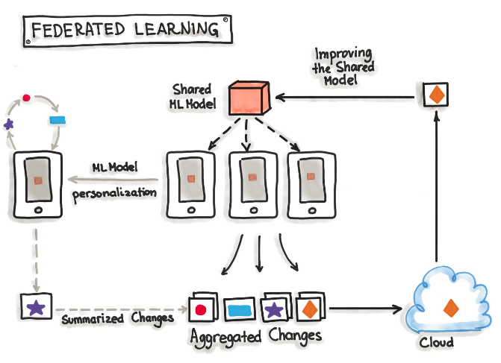
Hybrid-Serving (Federated Learning) 2
Not having any downsides for the users, while the server model gets updated, this happens only when the device is idle, connected to WiFi and charging
testing is done on the devices, therefore the newly adopted model from the server is sent to the devices and tested for functionality
Big benefit
data used for training and testing, which is highly personal, never leaves the devices while still capturing all data that is available
possible to train highly accurate models while not having to store tons of (probably personal) data in the cloud
Constraints
mobile devices are less powerful
the training data is distributed across millions of devices and these are not always available for training
Exactly for this TensorFlow Federated (TFF) has been created - lightweight form of TensorFlow

Slide 12
Deployment Strategies
Common ways for wrapping trained models as deployable services, namely deploying ML models as
Docker Containers to Cloud Instances
Serverless Functions

Slide 13
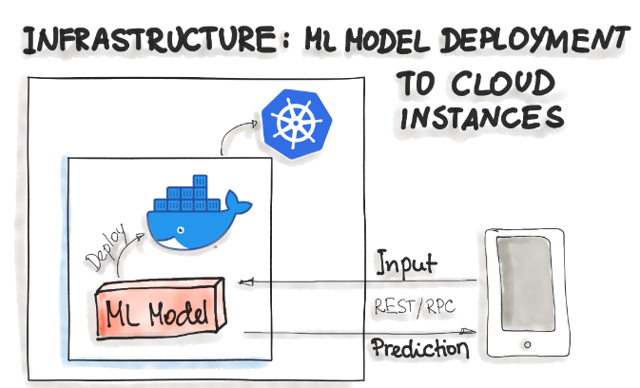
Deploying ML Models as Docker Containers
No standard, open solution to ML model deployment!
Containerization becomes the de-facto standard for delivery
as ML model inference being considered stateless, lightweight, and idempotent
means deploy a container that wraps an ML model inference code
Docker is considered to be de-facto standard containerization technology
for on-premise, cloud, or hybrid deployments
One ubiquitous way is to package the whole ML tech stack (dependencies) and the code for ML model prediction into a Docker container
Then Kubernetes or an alternative (e.g. AWS Fargate) does the orchestration
The ML model functionality, such as prediction, is then available through a REST API (e.g. implemented as Flask application)

Slide 14
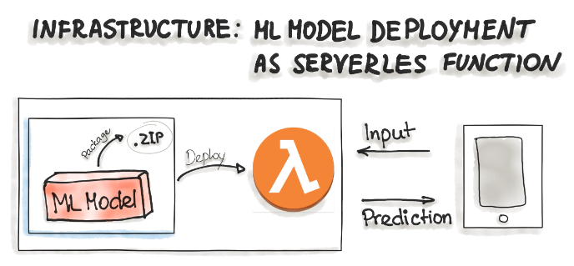
Deploying ML Models as Serverless Functions
Various cloud vendors already provide machine-learning platforms - can deploy model with their services
Amazon AWS Sagemaker, Google Cloud AI Platform, Azure Machine Learning Studio, and IBM Watson Machine Learning
Commercial cloud services also provide containerization of ML models such as AWS Lambda and Google App Engine servlet host
In order to deploy an ML model as a serverless function,
the application code and dependencies are packaged into .zip files, with a single entry point function
could be managed by major cloud providers such as Azure Functions, AWS Lambda, or Google Cloud Functions
However, attention should be paid to possible constraints of the deployed artifacts such as the size of the artifacts

Slide 15
Thank You!
In our next session:

